Slide 1
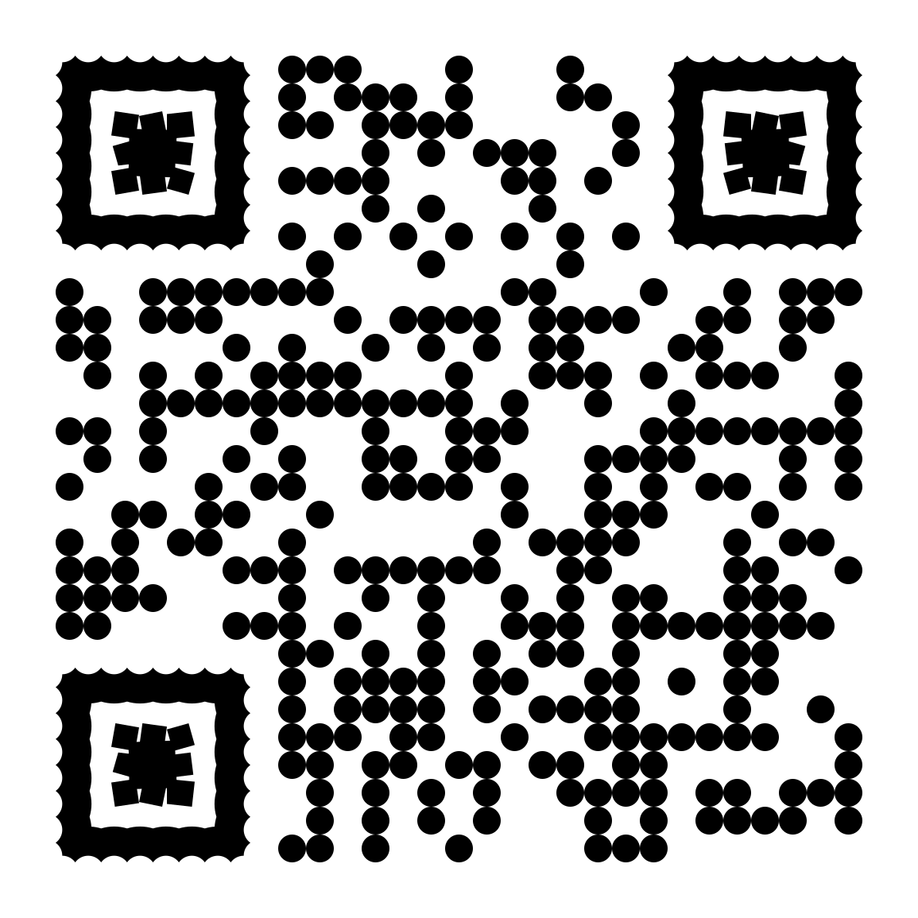
Scan
To connect with me
https://mavros-lykos.github.io/mylinks/

Slide 2
Installing Git 2.50.1

Slide 3
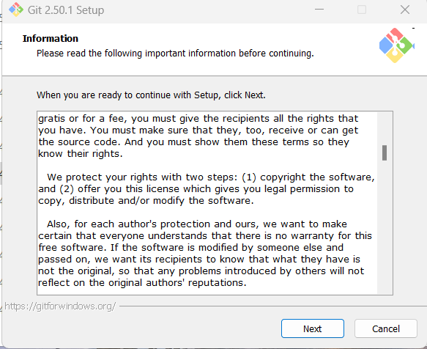

Slide 4
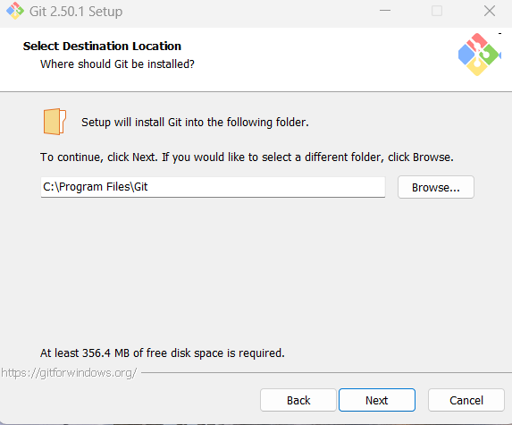

Slide 5
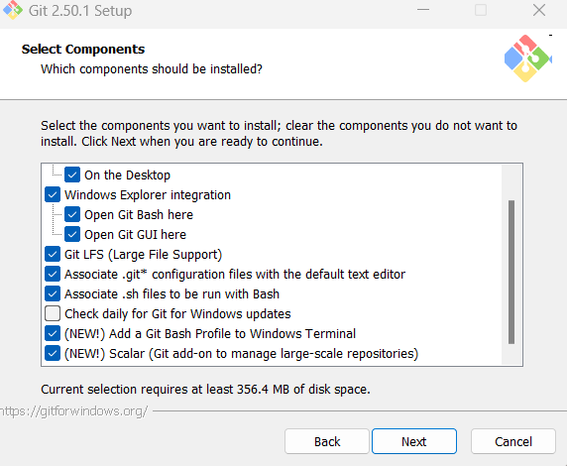
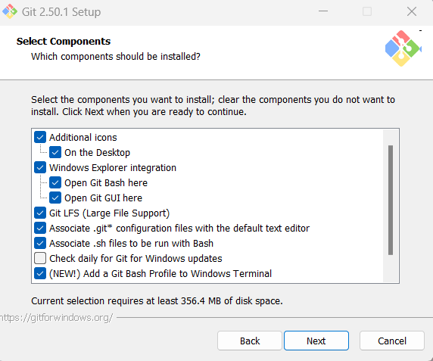

Slide 6
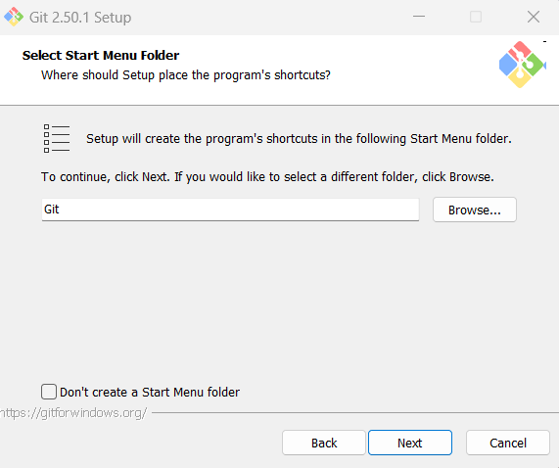

Slide 7
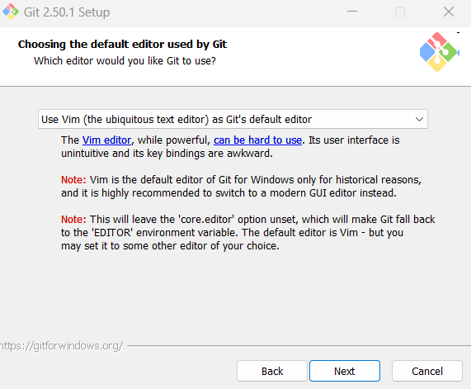
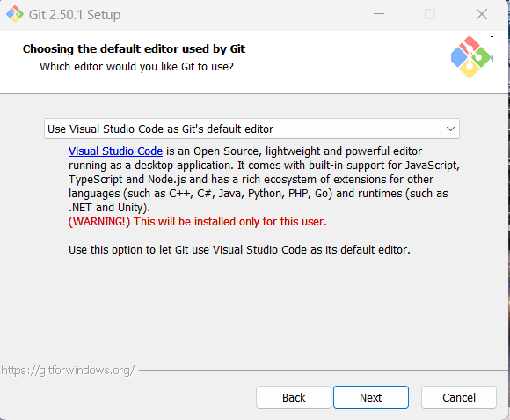

Slide 8
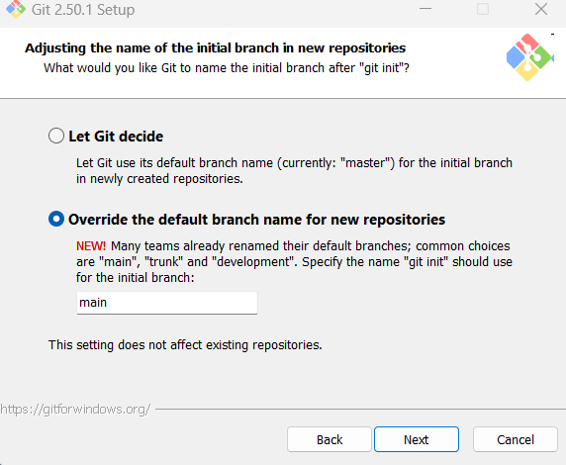

Slide 9
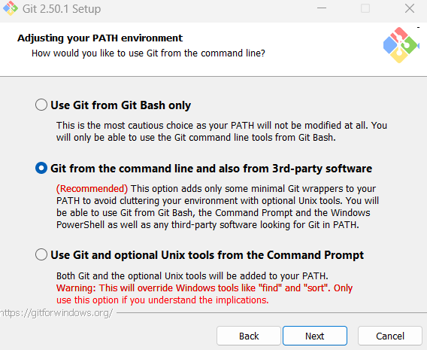

Slide 10
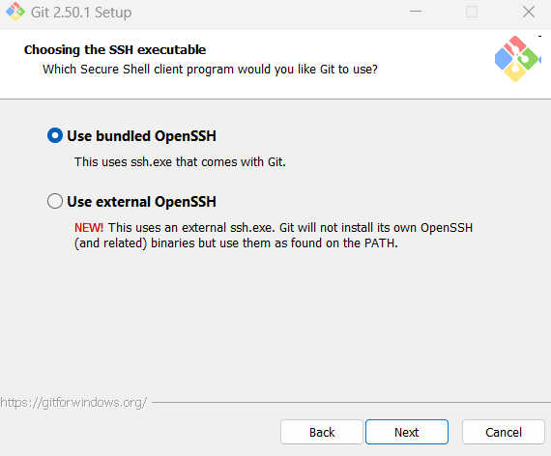

Slide 11
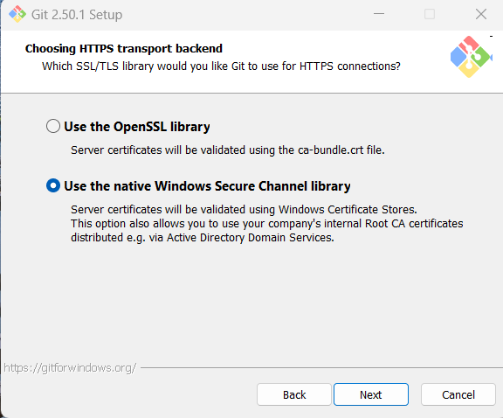

Slide 12
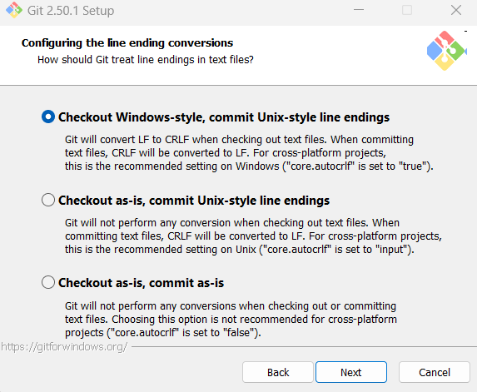

Slide 13
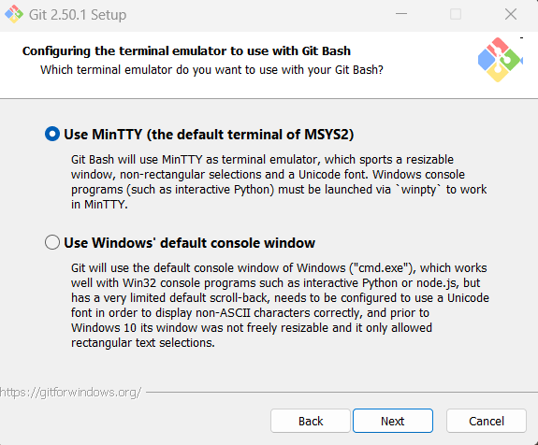

Slide 14
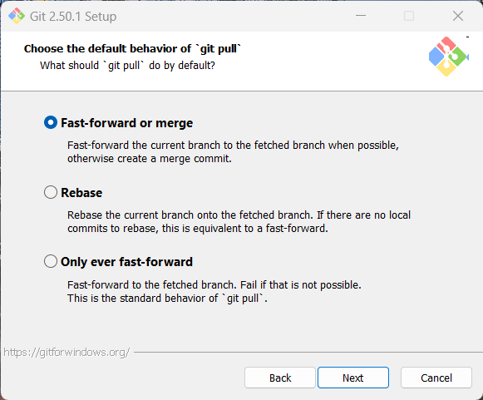

Slide 15
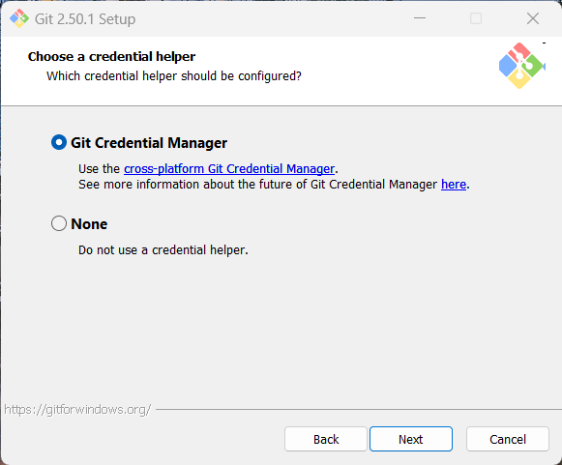

Slide 16
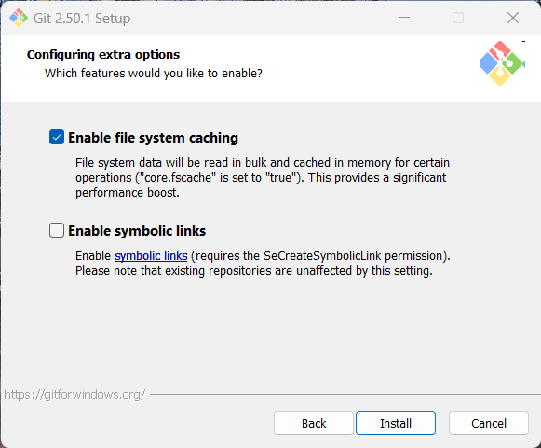

Slide 17
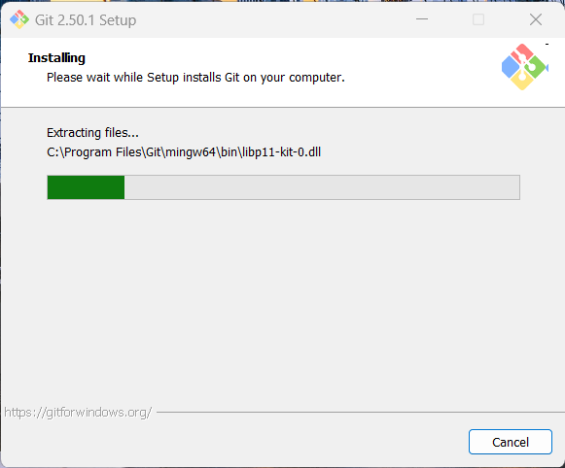

Slide 18
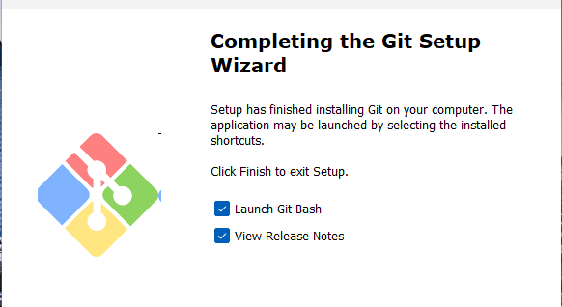

Slide 19

✅ Verify Installation
Open Git Bash (or PowerShell/Windows Terminal) and run:
git --version

Slide 20
🧑‍💻 Configure Your Identity
Important *****
Globally (affects all your repos):
git config --global user.name "Your Name"
git config --global user.email "your_verified_email@example.com"
Locally (only for a specific repo):
cd path/to/repo
git config user.name "Your Name"
git config user.email "your_verified_email@example.com"

